Slide 1

Multi-variate data Analysis and Prediction
Prathamesh Lawand : 371031
Om suryawanshi : 371071
Abhishek Walunj : 371065
Shital Madaswar : 371067

Slide 2
Introduction
Multivariate data analysis is a type of statistical analysis that involves more than two dependent variables, resulting in a single outcome.
Many problems in the world can be practical examples of multivariate equations as whatever happens in the world happens due to multiple reasons.
The multivariate model is a popular statistical tool that uses multiple variables to forecast possible outcomes.
Research analysts use multivariate models to forecast investment outcomes in different scenarios in order to understand the exposure that a portfolio has to particular risks.

Slide 3
Motivation
Information visualization is the use of computer-based interactive visual representations of abstract and non-physically based data to amplify human recognition.
While information is growing in an exponential way, our world is flooded with data which, we believe, should contain some kind of valuable information that can possibly expand the human knowledge
Multivariate data are encountered in all aspects by researchers, scientists, engineers, manufacturers, financial managers and various kinds of analysts. Multivariate data visualization is hence strongly motivated by the many situations when they are trying to obtain an integrated understanding of the data distributions and investigate the inter-relationships between different data attributes

Slide 4
Challenges
Multivariate data visualization faces the same challenges as information visualization does: Finding good visual representations of a problem can be hard and undeterministic . In addition, multivariate data poses problems in encoding its attributes in a single visual display
Mapping: Finding a suitable mapping of high-dimensional multivariate data into a 2D visual form is never a simple task. It usually depends on the nature of datasets to be visualized and is more related to human perception. Also, association of data attributes to graphical entities requires extreme caution to avoid overwhelming the observer’s viewing ability
.

Slide 5
Visualization And Analysing Techniques
Geometric Projection:
Scatterplot
Scatterplot is used for bivariate discrete data in which two attributes are projected along the x-y axes of the Cartesian coordinates. Scatterplot matrix is an extension for multidimensional data where a collection of scatterplots is organized in a matrix simultaneously to provide correlation information among the attributes
Bar graph

Slide 6
Random Forest Regression
Random Forest Regression is a supervised learning algorithm that uses ensemble learning method for regression. Ensemble learning method is a technique that combines predictions from multiple machine learning algorithms to make a more accurate prediction than a single model.
Pick at random k data points from the training set.
Build a decision tree associated to these k data points.
Choose the number N of trees you want to build and repeat steps 1 and 2.
For a new data point, make each one of your N-tree trees predict the value of y for the data point in question and assign the new data point to the average across all of the predicted y values.

Slide 7
Random Forest Regression Model: We will use the sklearn module for training our random forest regression model, specifically the RandomForestRegressor function. The RandomForestRegressor documentation shows many different parameters we can select for our model. Some of the important parameters are highlighted below:
n_estimators
criterion
max_depth
max_features
bootstrap max_sample

Slide 8
Why Random Forest Regression?
It’s more accurate than the decision tree algorithm.
It provides an effective way of handling missing data.
It can produce a reasonable prediction without hyper-parameter tuning.
It solves the issue of overfitting in decision trees.
In every random forest tree, a subset of features is selected randomly at the node’s splitting point.

Slide 9
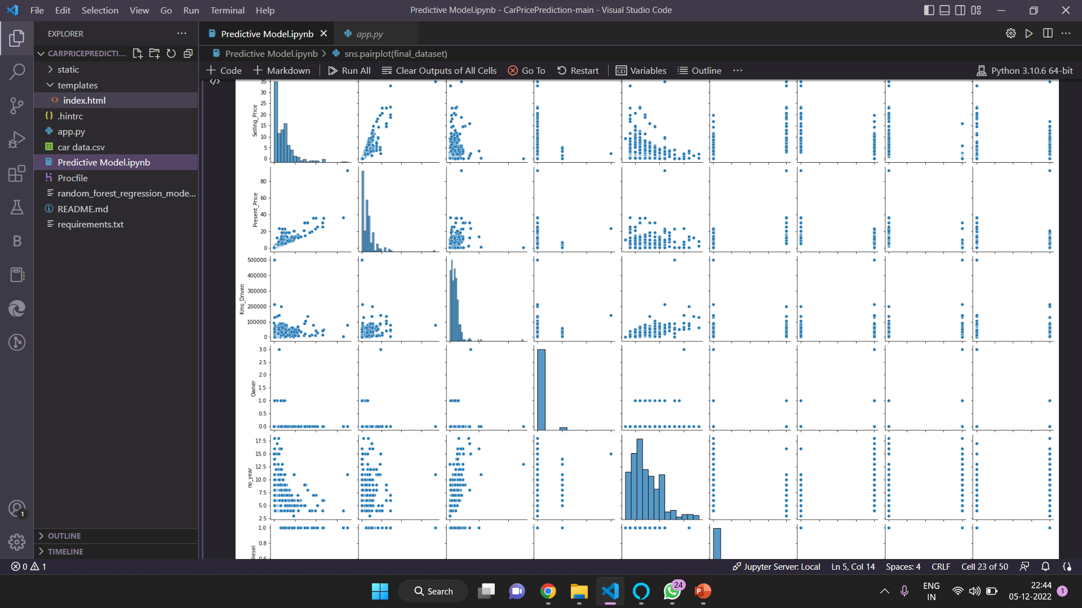
Result

Slide 10
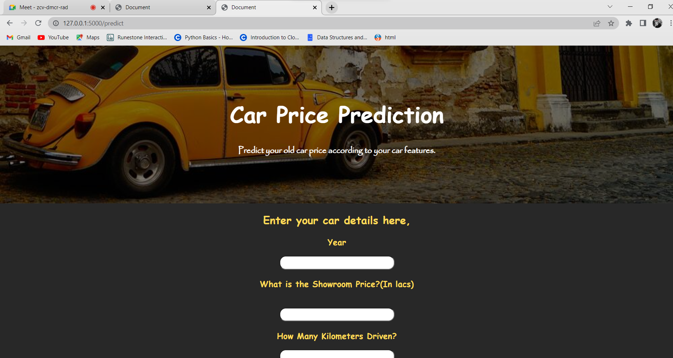

Slide 11
Conclusion
In this project, we reviewed some important techniques for multivariate data visualization. Then we visualized the data of car and analyzed it . After analyzing the data we create a html web-page where user can insert the car features then our software calculate the prize for car which is optimal prize according to information.

Slide 12
Thank you

